Slide 1
Application Development in the IOS Environment (41889) Group 136 Tutor Daniel Ebrahimian
Hongjie Jia 12129856
Jiahao Pan 12520173
Shaohua Yu 12434181
Wanting Zhu 12671626

Slide 2

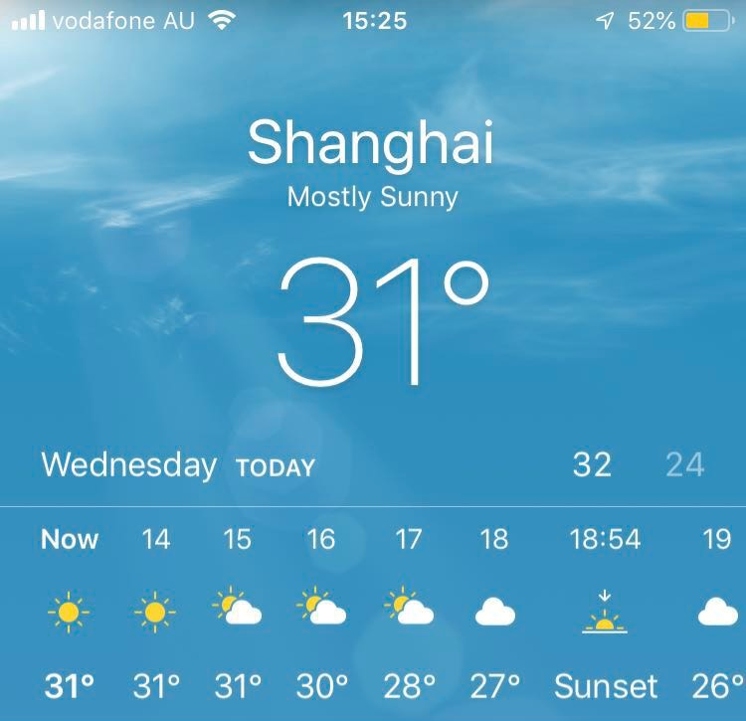
The apple’s weather app

Slide 3

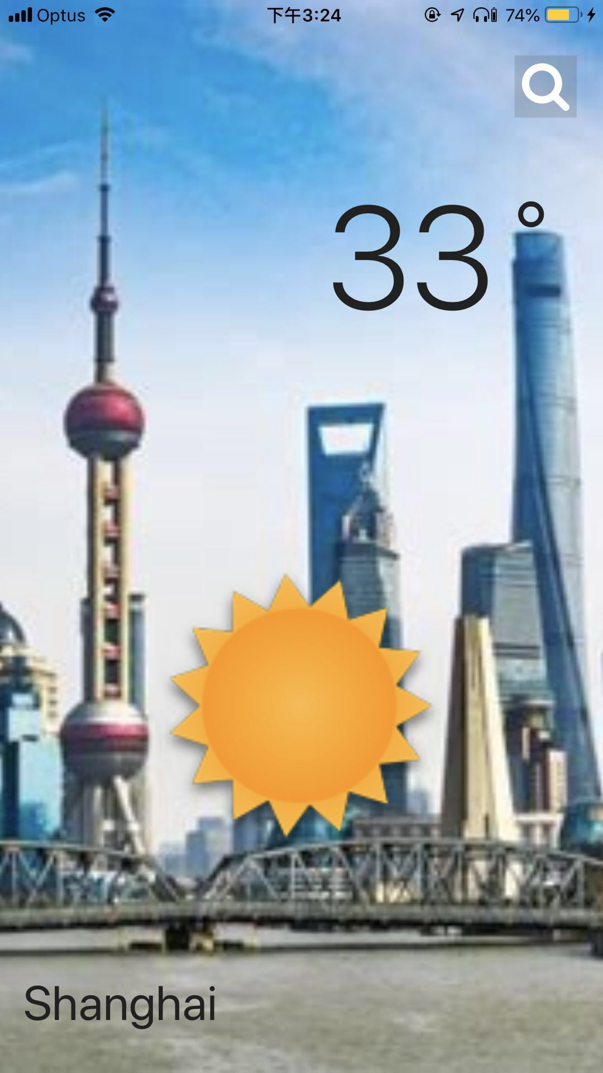
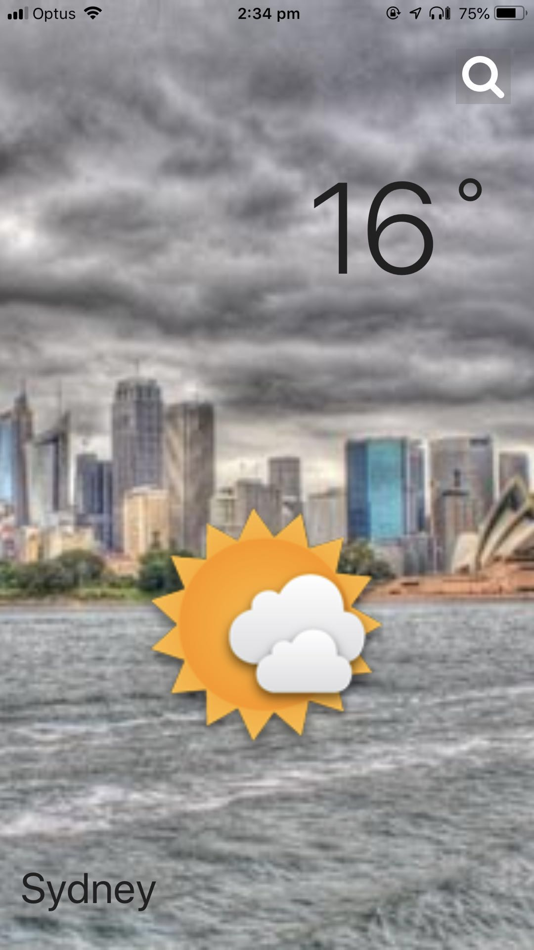



This our weather app
What‘s the different with apple weather app ?

Slide 4
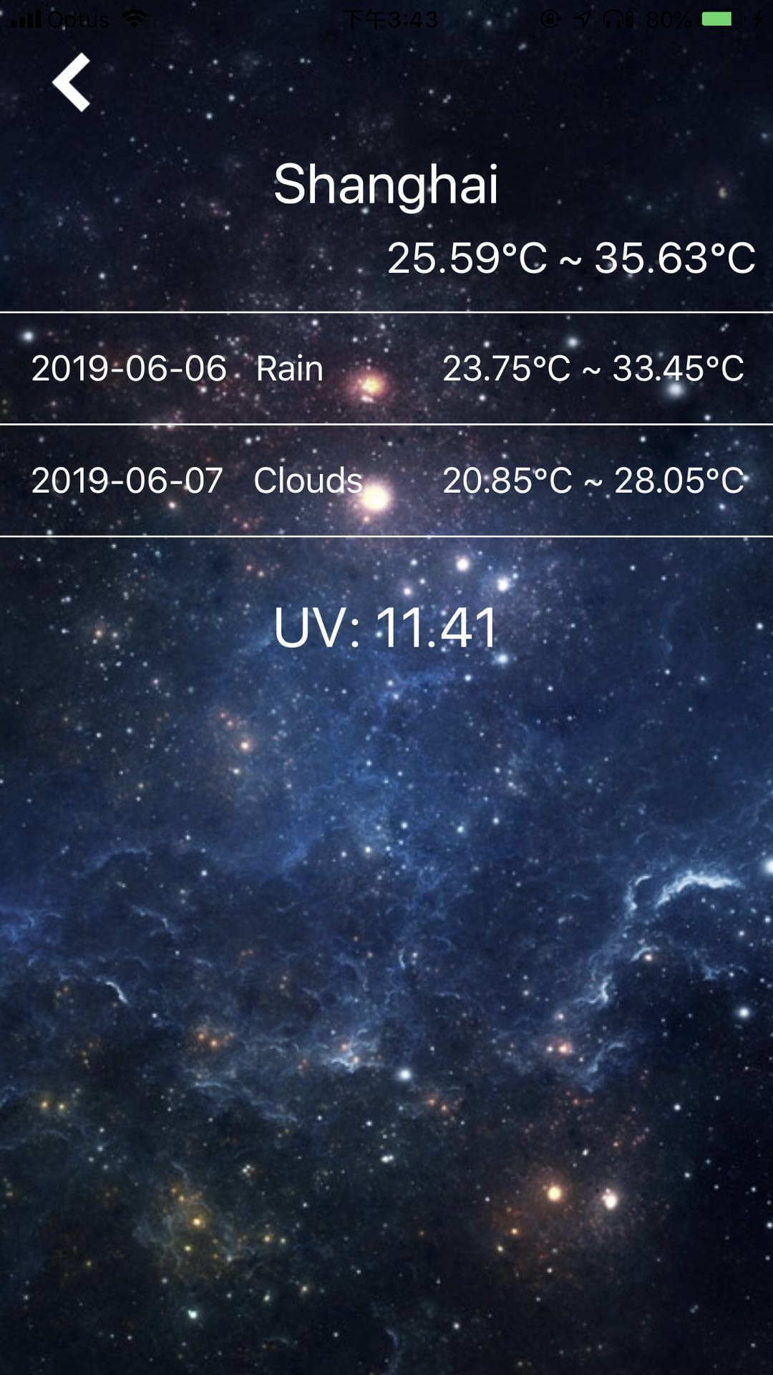
More weather information about current city

Slide 5
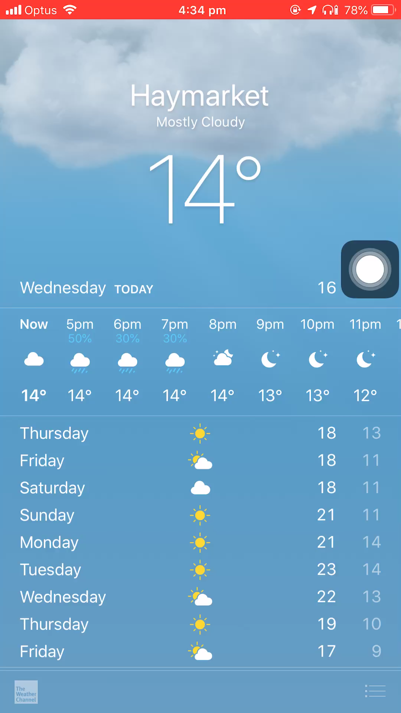
If I want to search other cities weather, how can I do use apple’s weather app?

Slide 6
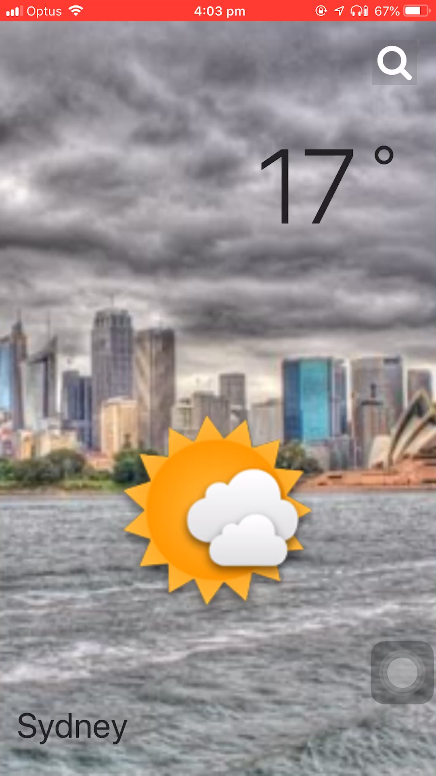
Search weather in our app

Slide 7
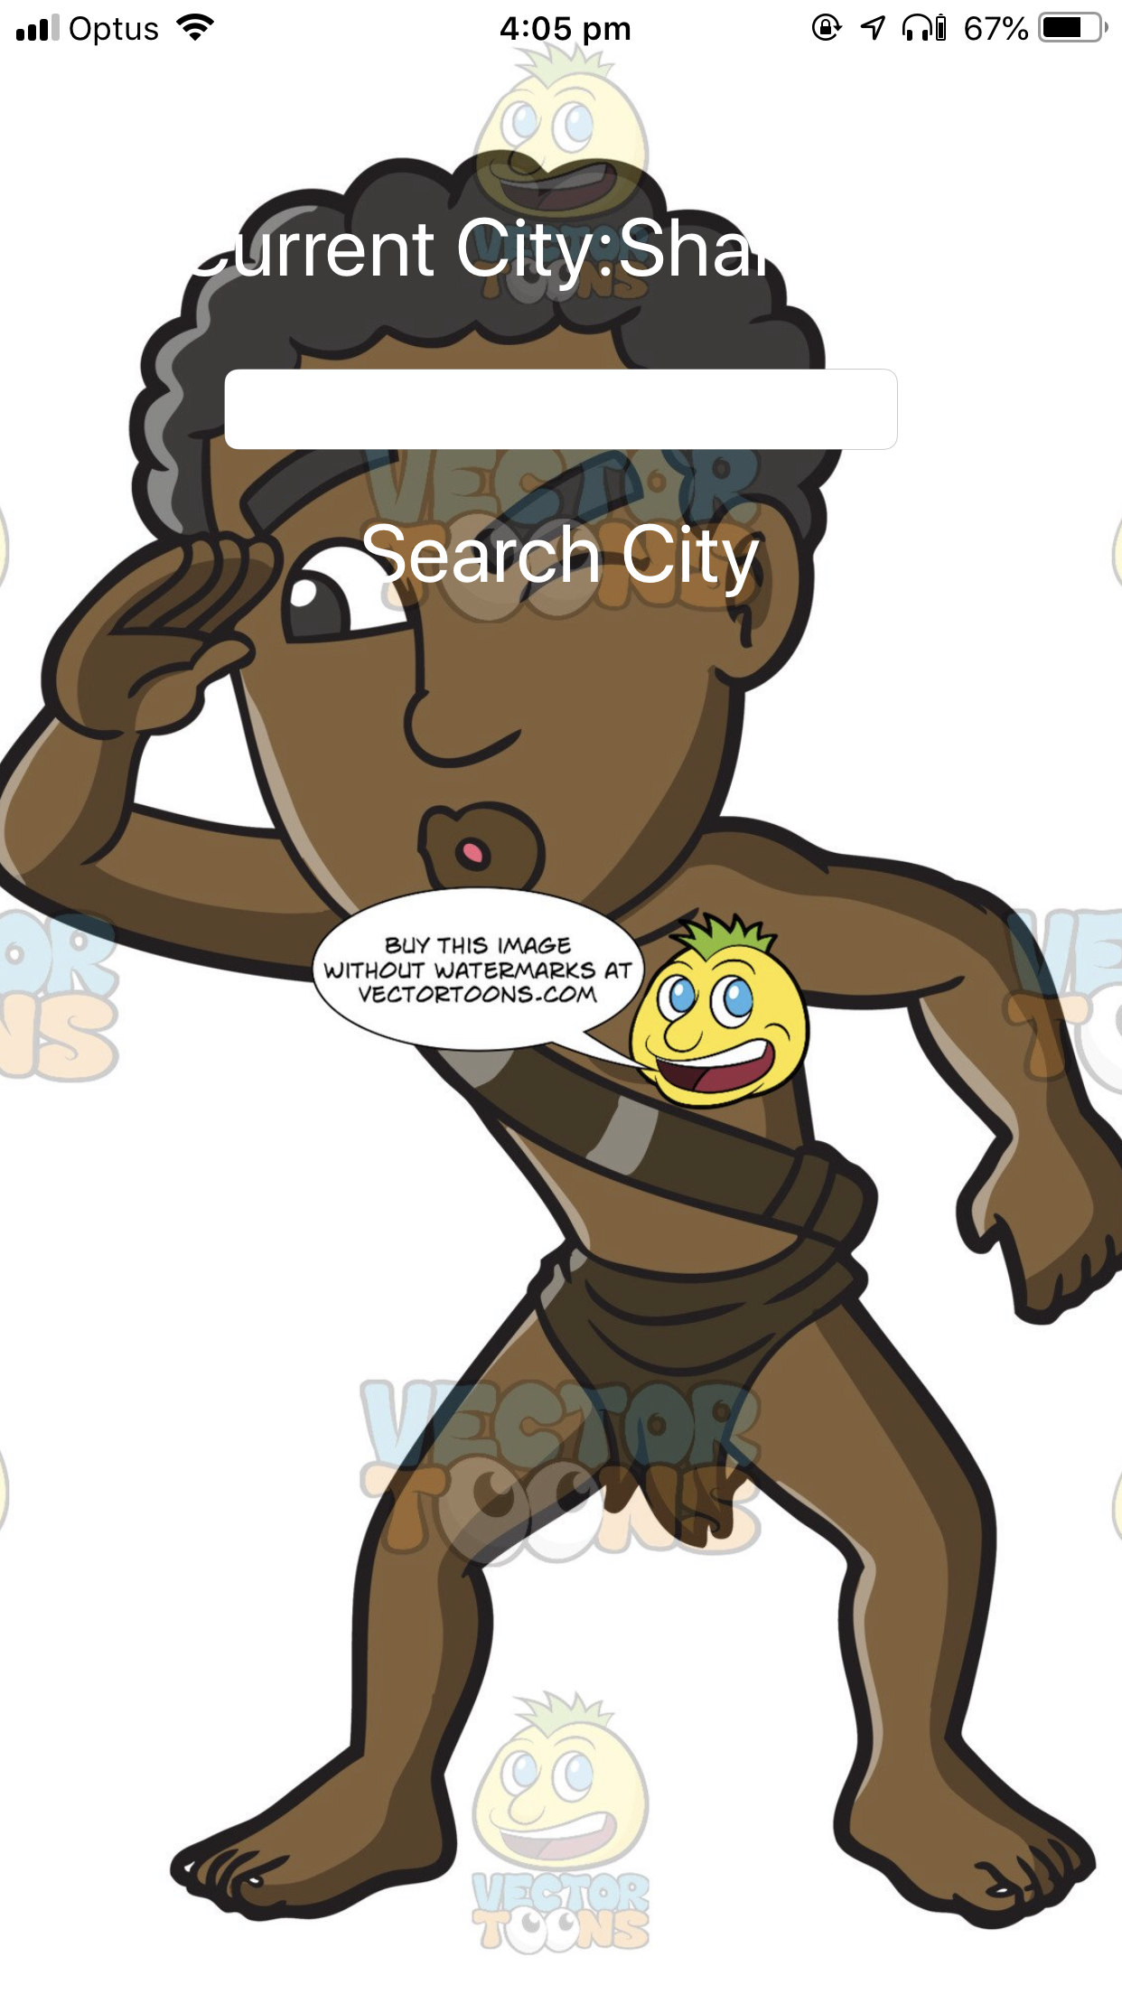
Interesting technologies
Locate users location
Call APIs

Slide 8
APIs
Get the weather and UV
Open weather map
Two kits: Alamofire - making a request & response handling
SwiftJson – Json -> JSON
Get the real time background image
Bing
Compound search – Depends on the location and weather

Slide 9
THANKS FOR LISTENING !
ANY QUESTIONS?

